Slide 1
NLP Applications
Manish Gupta
Principal Applied Scientist at Microsoft
Adjunct Faculty at IIIT-H
Visiting Faculty at ISB
Credits: Content has been taken from several papers and blogs.

Slide 2
Agenda
Popular NLP technologies

Slide 3
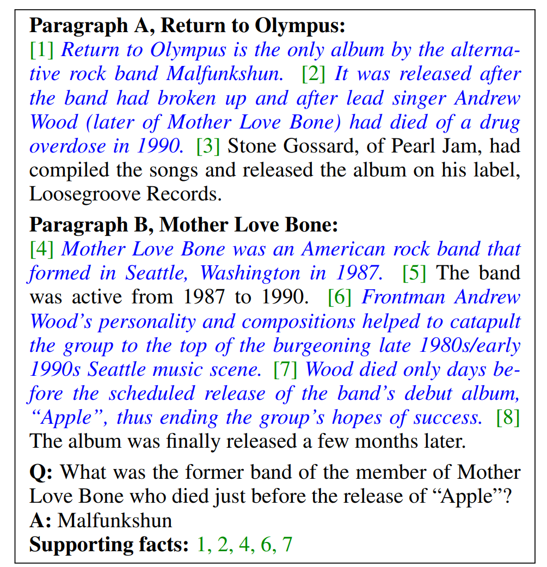
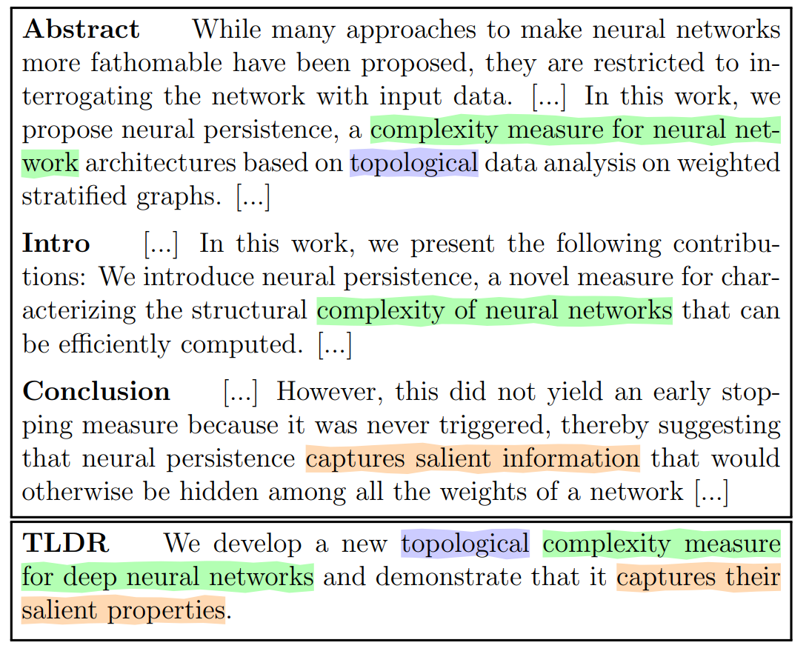
Summarization
Question Answering

Slide 4
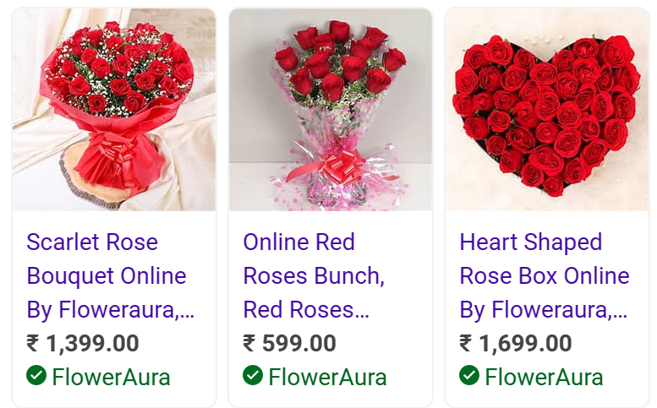

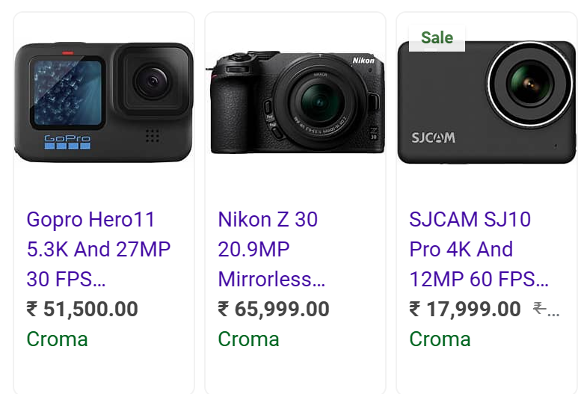
Machine Translation
Ads Copywriting

Slide 5
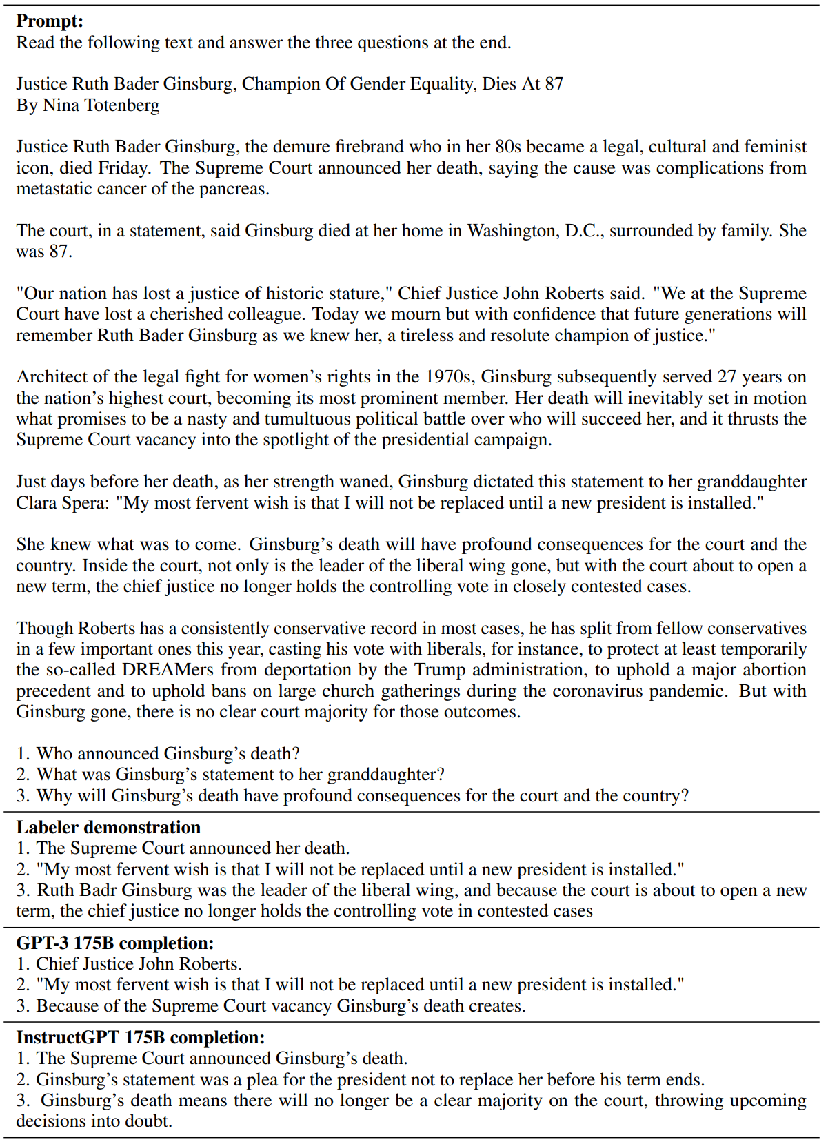
Machine Reading Comprehension

Slide 6
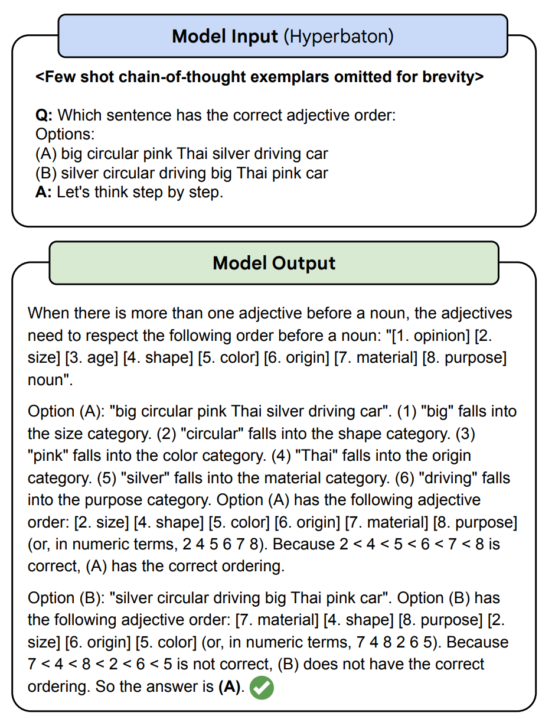
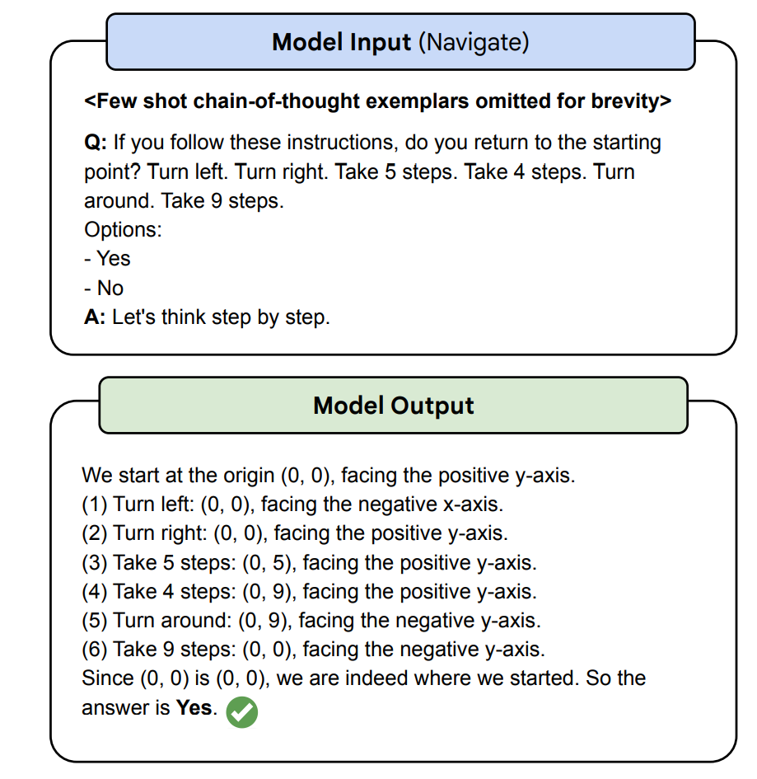
Solving reasoning problems

Slide 7
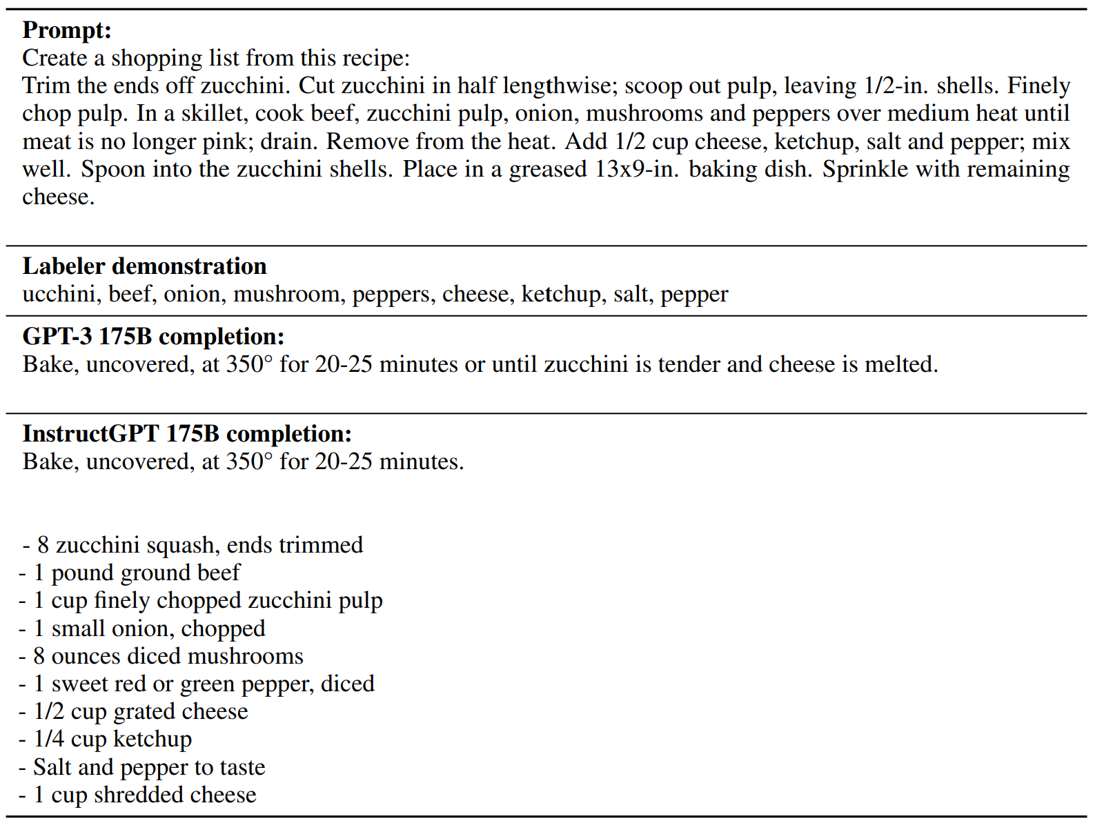
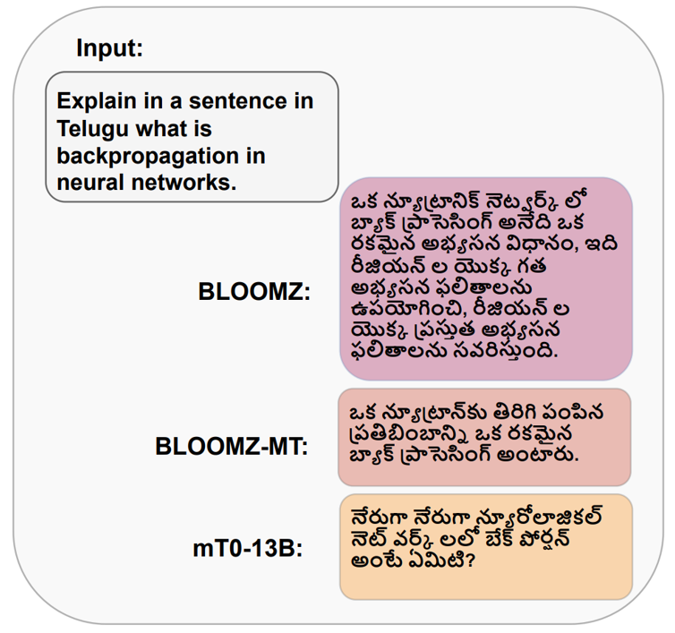
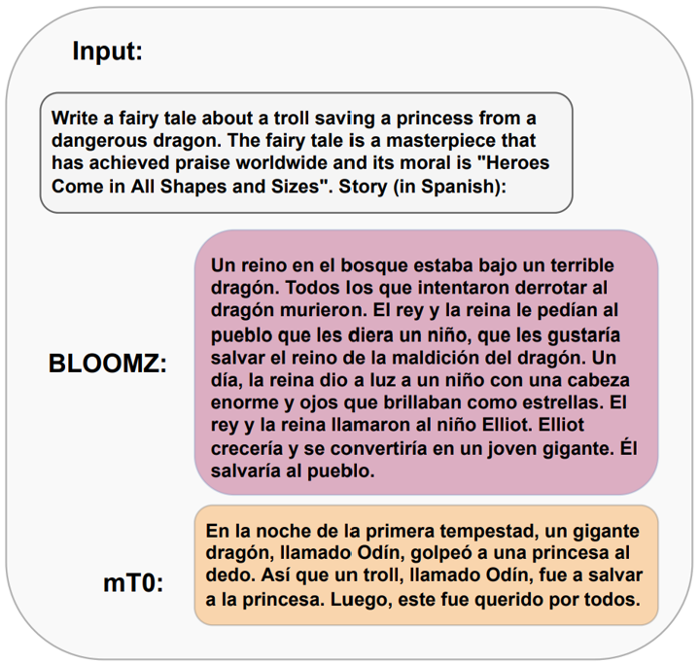
Create lists
Multi-lingual generation

Slide 8
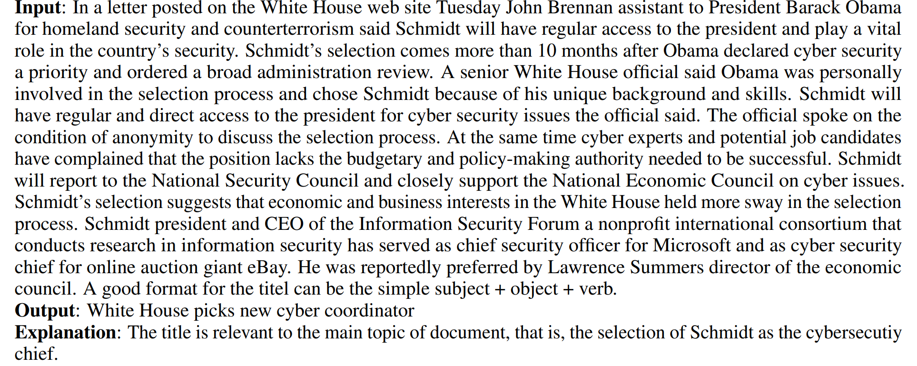
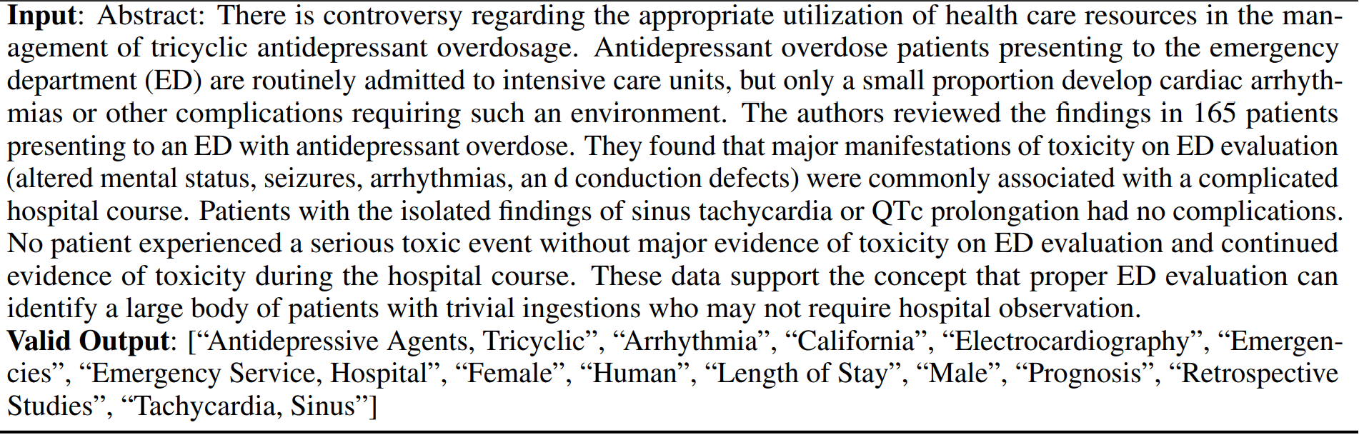
Title Generation
Keyword Tagging

Slide 9
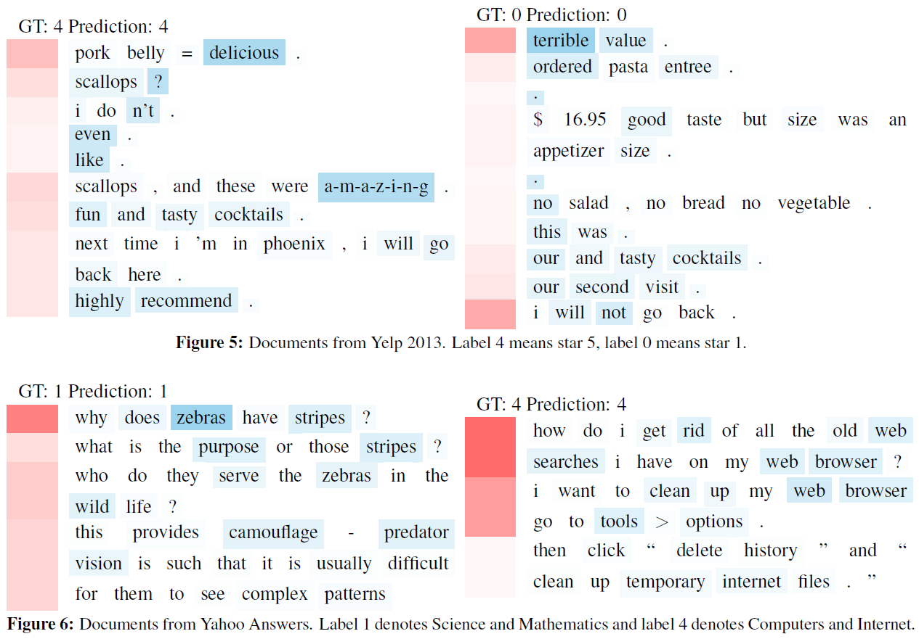
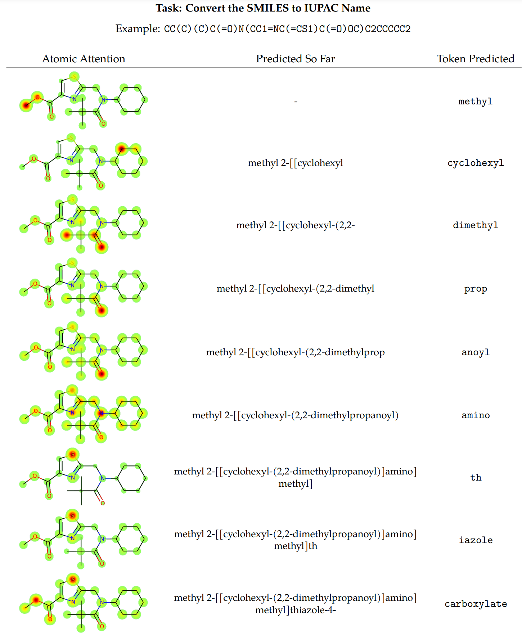
Sentiment Analysis
Chemical understanding

Slide 10
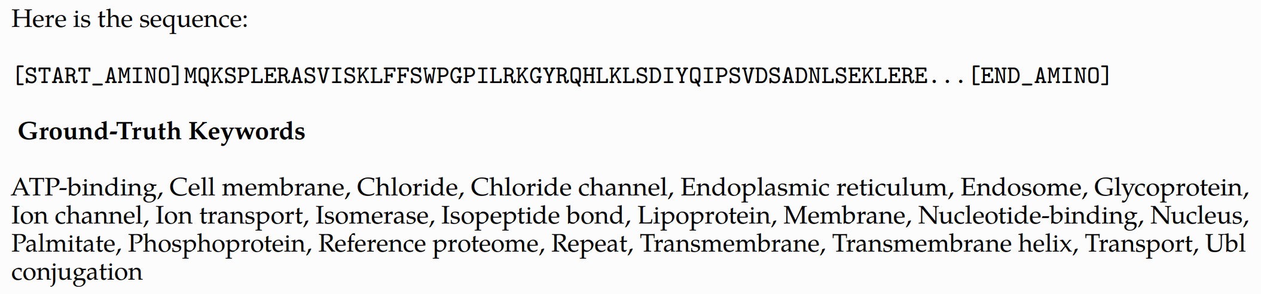
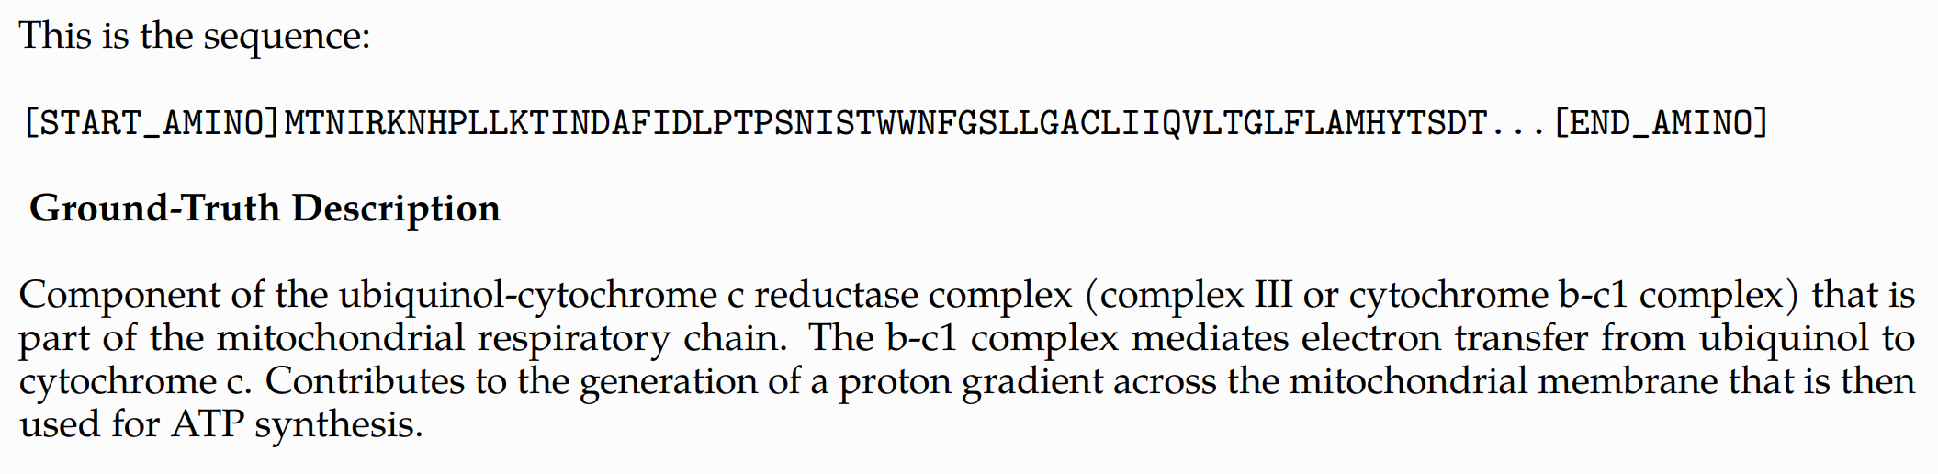
Biological understanding and drug design
Functional Keyword Prediction
Protein Function Description

Slide 11
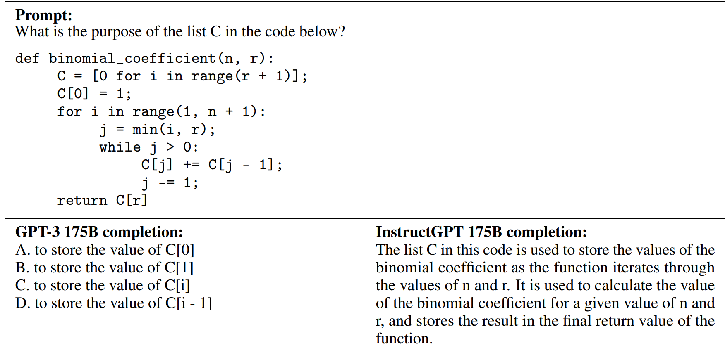
Explaining Code

Slide 12
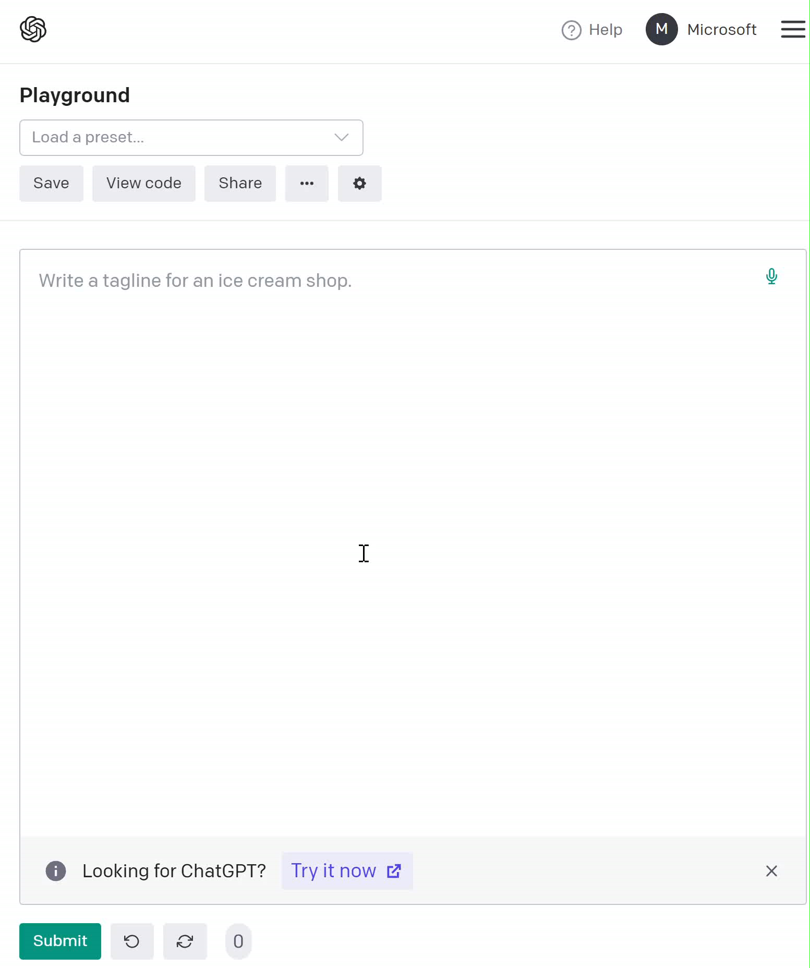
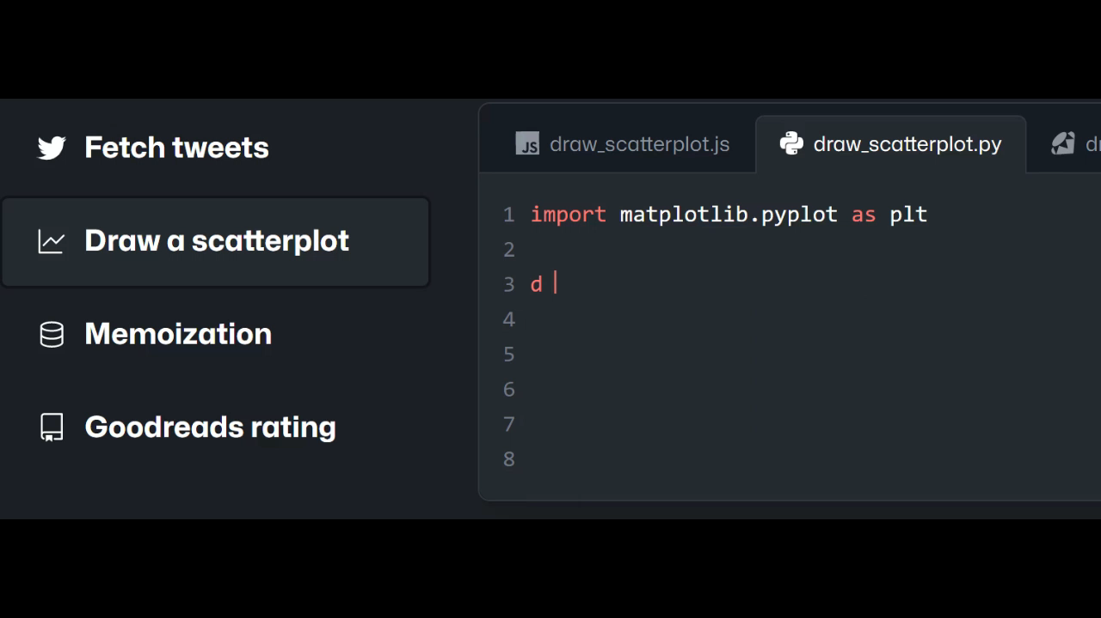
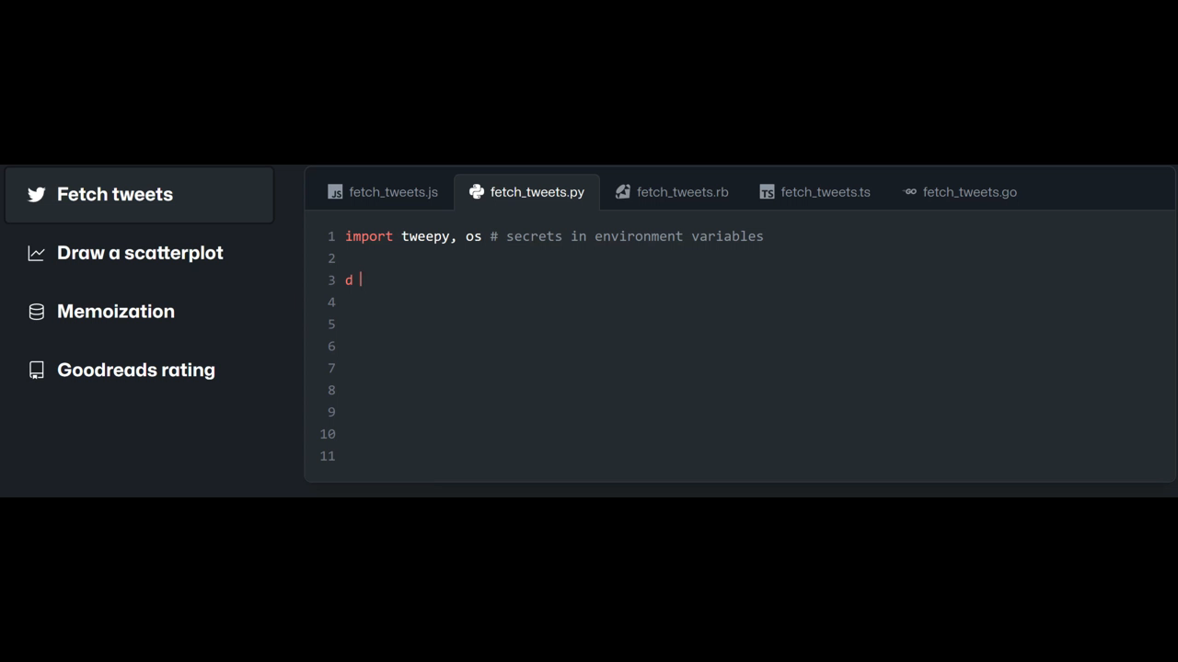
Essay Writing
Github Copilot

Slide 13
Agenda
Popular NLP technologies
Query Auto-Completion

Slide 14
Agenda
Components in Query Auto Completion systems
Natural Language Generation
Personalization
Handling defective suggestions and prefixes

Slide 15
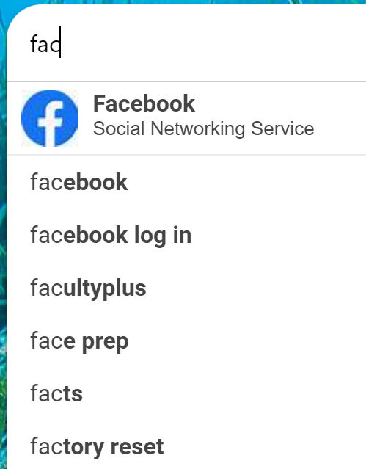
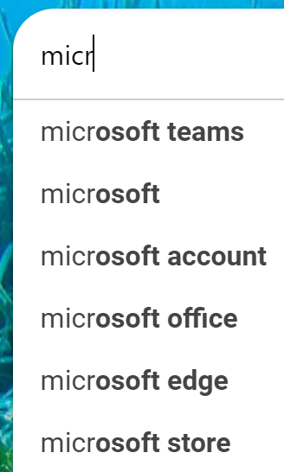
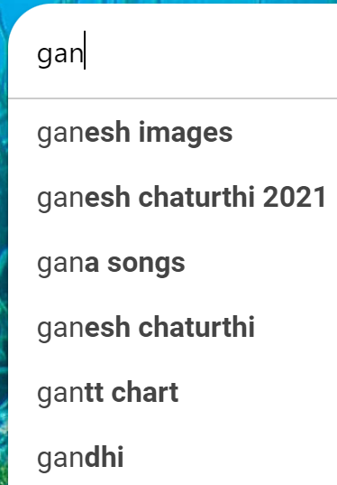
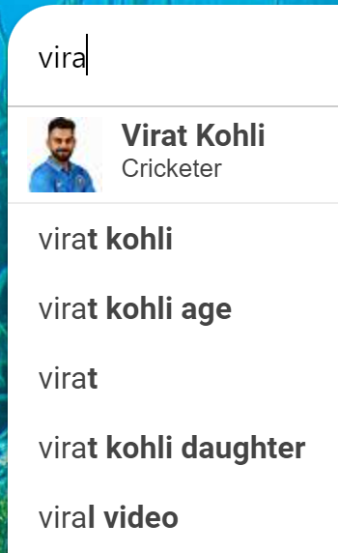
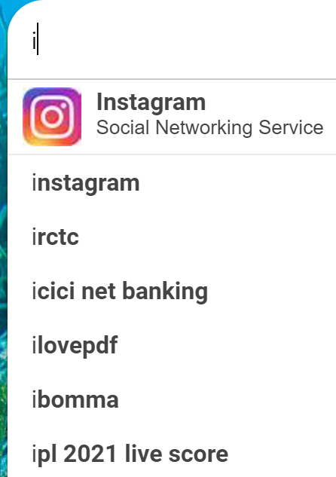
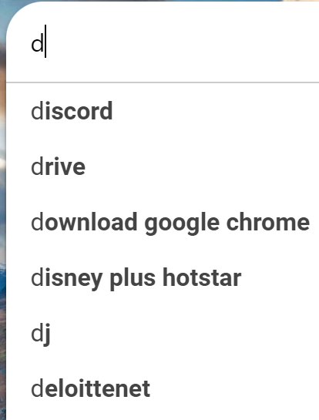
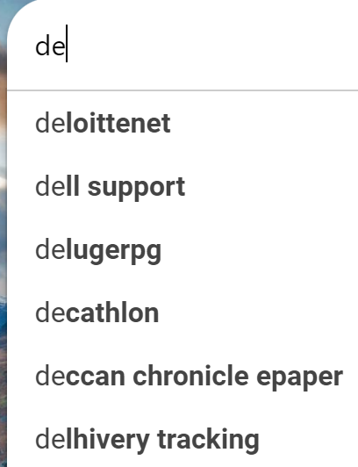
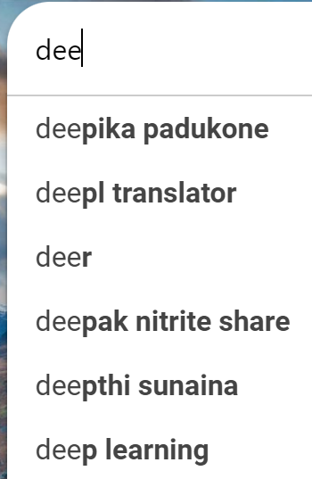
AutoSuggest Examples
Prefix
Conversation
Block

Slide 16
Important Components in a QAC system
Ranking suggestions
Most popular completion
Time sensitive suggestions
Location sensitive suggestions
Personalization
Ghosting, Session co-occurrences
Online spell correction, Defect handling
Non-prefix matches, Generating suggestions
Mobile QAC, Enterprise QAC

Slide 17
Ranking suggestions: Most Popular Completion (MPC)
“Wisdom of the crowds” MPC solution
A trie indexes historical queries along with popularity values.
Candidates=suggestions from trie that match the prefix.
Rank candidates by a function of its past popularity
Language specific popularity
Region specific popularity
Vary the query-log aggregation period
For shorter prefix lengths, a shorter query-log aggregation period is optimal, and vice-versa [Whiting 2013]
Can also rank by clicks
But click data is sparse
Whiting, Stewart, Andrew James McMinn, and Joemon M. Jose. "Exploring Real-Time Temporal Query Auto-Completion." In DIR, pp. 12-15. 2013.

Slide 18
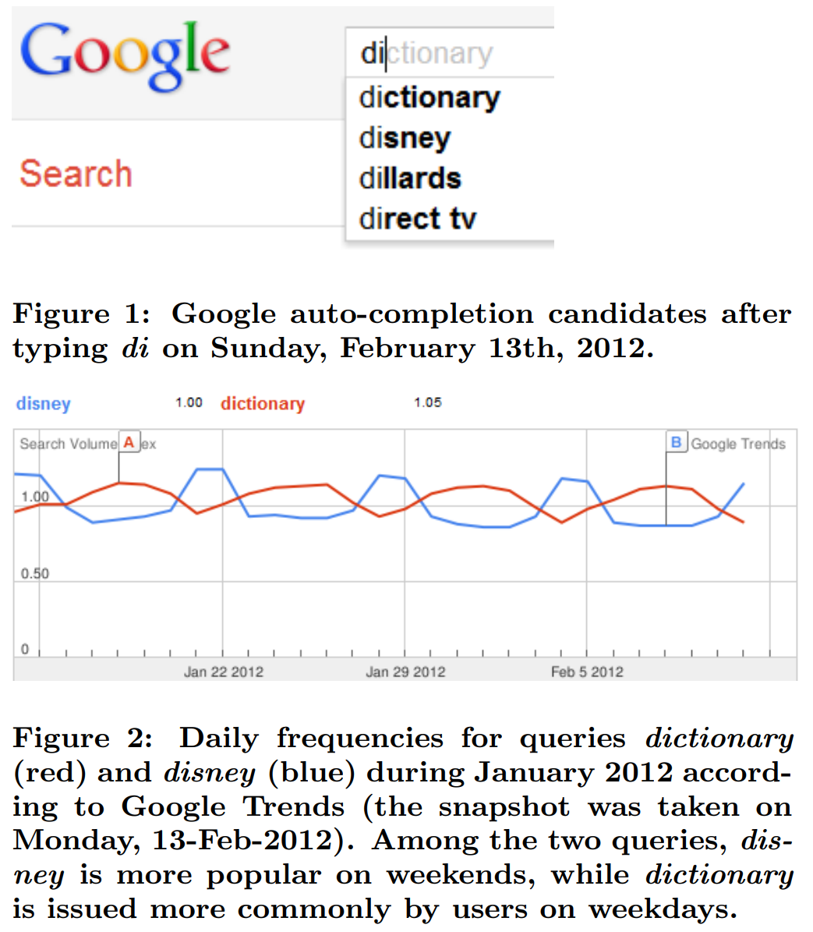
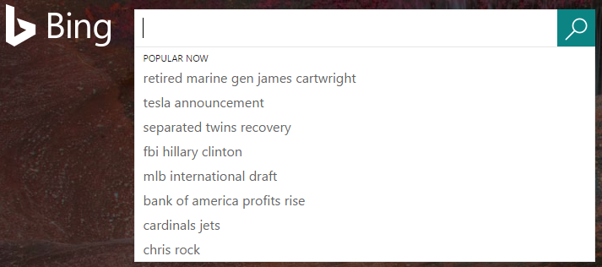
Ranking suggestions: Time sensitive suggestions
Predictably vs unpredictably popular
Predictably popular queries: temporally recurring (e.g. at Christmas, in January, etc.) or known/foreseeable events and phenomena (e.g. TV episodes, sporting events, expected weather etc.).
Ranking of candidates must be adjusted with time. “halloween” might be the right suggestion after typing “ha” in October, “harry potter” might be better any other time.
Unpredictably popular queries: unforeseeable current events and phenomena (e.g. breaking news).
“sarah burke” got bursty in Jan 2012, vs the usually popular “sarah palin”
Instead of past popularity, can we rank candidates based on forecasted frequencies?
Can use typical time series forecasting methods like ARIMA, exponential smoothing, … [Shokouhi, 2012]
Model as a ranked Multi-armed Bandit problem [Wang, 2017]
Shokouhi, Milad, and Kira Radinsky. "Time-sensitive query auto-completion." In SIGIR, pp. 601-610. 2012.
Wang, Yingfei, Hua Ouyang, Hongbo Deng, and Yi Chang. "Learning online trends for interactive query auto-completion." IEEE Transactions on Knowledge and Data Engineering 29, no. 11 (2017): 2442-2454.

Slide 19
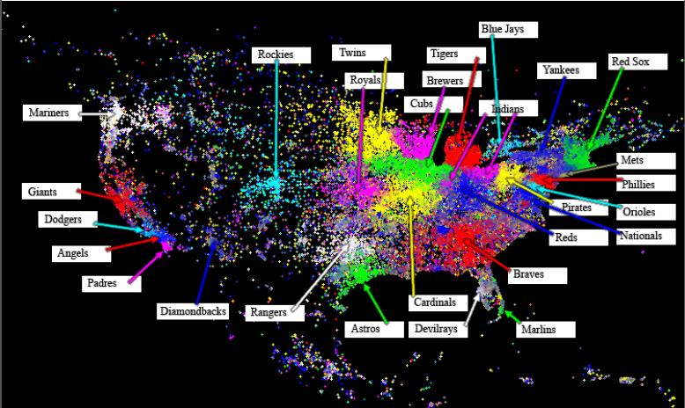
Ranking suggestions: Location sensitive suggestions
A user in San Diego types “Uni”.
“Univ of California, San Diego” is ok.
“Univ of California, Los Angeles” is not ok at the top.
Location sensitivity of queries
Local interest queries [Backstrom, 2008]
Queries only interesting to users at particular location
e.g., name of local high school, newspaper
Find center of geographic focus and dispersion for query
Determine if query is tightly concentrated or spread diffusely geographically
Localizable queries
Users at different locations may issue the same query, but referring to different things
e.g., pizza hut, house for rent.
A localizable query is likely to appear as a sub query in other queries, associating with different locations. “car rental california”, “car rental new york”, etc
Backstrom, Lars, Jon Kleinberg, Ravi Kumar, and Jasmine Novak. "Spatial variation in search engine queries." In WWW, pp. 357-366. 2008.
Welch, Michael J., and Junghoo Cho. "Automatically identifying localizable queries." In SIGIR, pp. 507-514. 2008.

Slide 20



Ranking Suggestions: Personalization
Using short-term/long-term user history, location, other signals
Search/Click History:
the wolf of wall street
the revenant
inception
gangs of new york
pain & gain
Search/Click History:
tender is the night
f. scott fitzgerald
this side of paradise
the silent patient
the great gatsby book
Search/Click History:
the wolf of wall street
the revenant
inception
gangs of new york
pain & gain
Long-term
Session history
beijing travel advisory
forbidden city
the great gatsby fitzgerald
the great gatsby book
the great influenza
the great alone book
the great gatsby film 2013
the great gatsby film 2013
the great gatsby trailer
the great gatsby film 1974
the greatest showman
the great wall film 2016
the great wall of china
the great gatsby film 2013
the great gatsby trailer
the great gatsby film 1974
the greatest showman

Slide 21
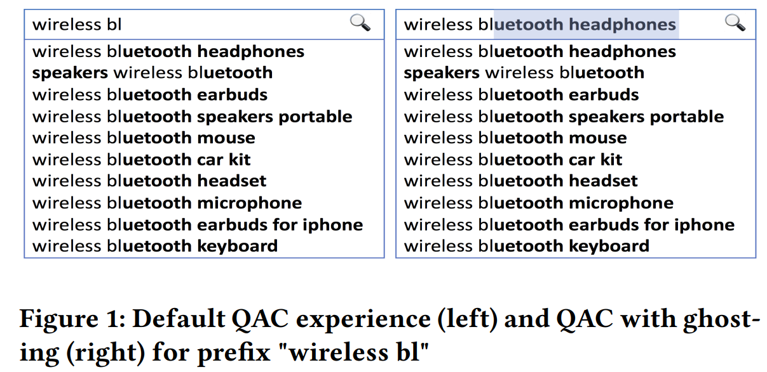
Ghosting, Session co-occurrences
Ghosting: auto-completing a search recommendation by highlighting the suggested text inline i.e., within the search box.
Session-context ghosting increased the acceptance of offered suggestions by 6.18% and reduced misspelled searches by 4.42% [Ramachandran et al, 2019]
Context sensitive AS [Bar-Yossef et al. 2011]
After “richard nixon” the most popular successive query starting with “am” is “american presidents”.
Handle sparsity of co-occurrences
clustering similar query sequences together
similarity may be syntactic (e.g., american airlines → american airlines flight status) or only semantic (e.g., american airlines → continental).
Ramachandran, Lakshmi, and Uma Murthy. "Ghosting: contextualized query auto-completion on Amazon search." In SIGIR, pp. 1377-1378. 2019.
Bar-Yossef, Ziv, and Naama Kraus. "Context-sensitive query auto-completion." In WWW, pp. 107-116. 2011.

Slide 22
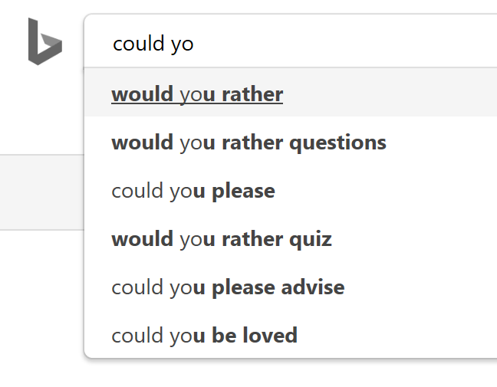
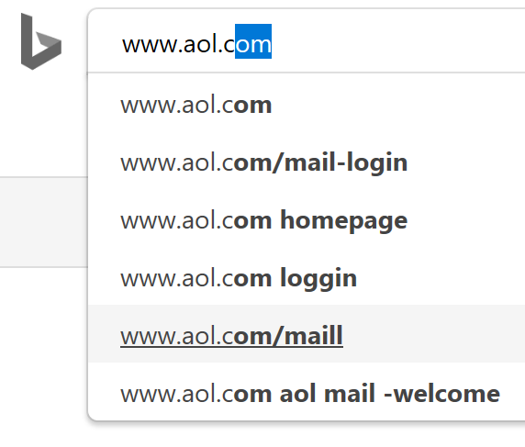
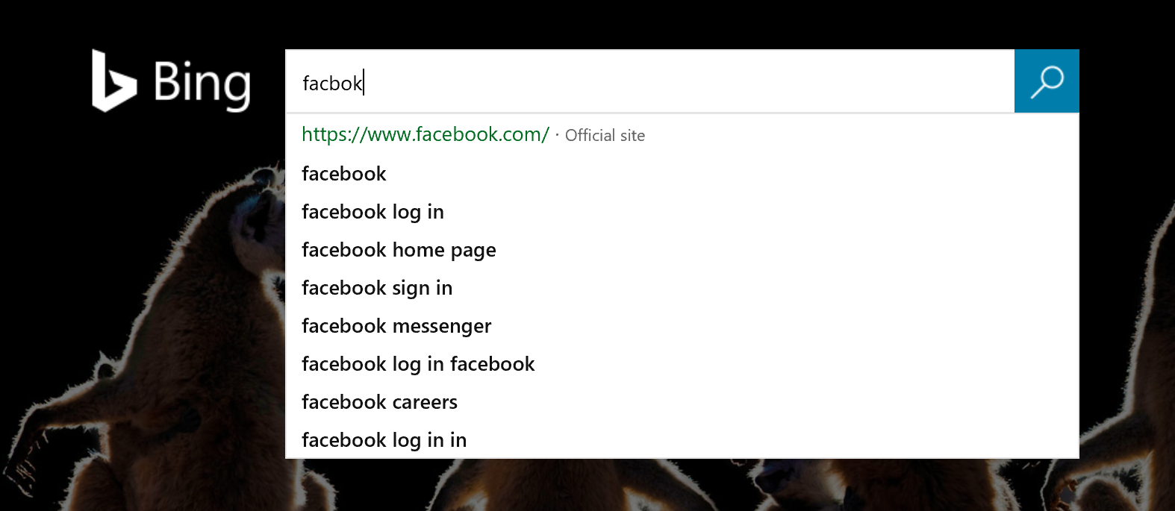
Online spell correction, Defect handling
Small portions of the prefix can be corrected at trie exploration time paying a penalty cost. E.g. “cbo” → “ceboo”
More flexible than Offline Speller because small portions of the prefix can be changed
More coverage
Key idea: it is possible to jump to a different node in the search trie paying a cost dictated from the Conversion table
Defects
Spelling mistakes
Offensive suggestions
Partial suggestions
Rare intents
Non-sensical suggestions/hallucinations
Gibberish
Bad URL
Duan, Huizhong, and Bo-June Hsu. "Online spelling correction for query completion." In Proceedings of the 20th international conference on World wide web, pp. 117-126. 2011.

Slide 23
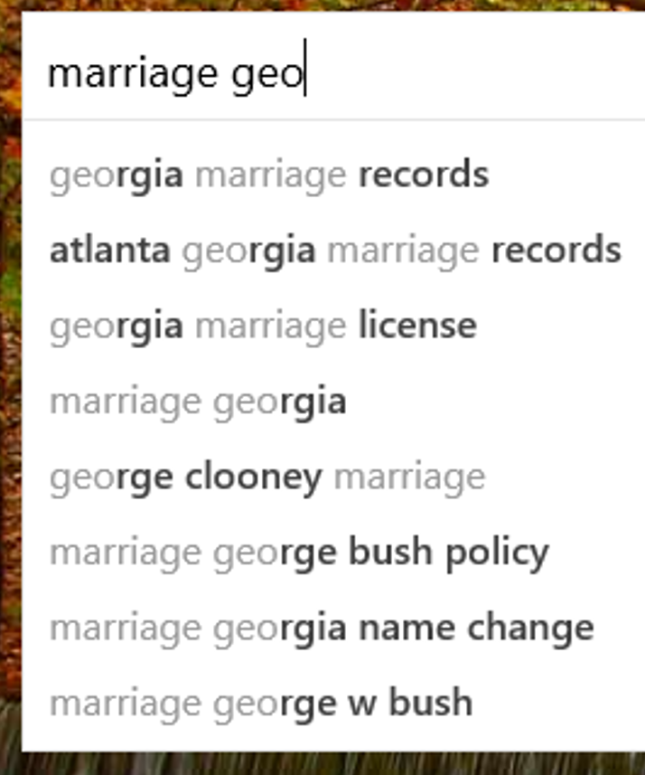
Non-prefix matches, Generating suggestions
Non-prefix matches
If Q is “shrimp dip rec”, then a plausible completion found by prefix-search could be “shrimp dip recipes”.
A multiterm prefix-search could return, instead, “shrimp bienville dip recipe” or “recipe for appetizer shrimp chipotle dip”.
Use inverted index.
A significant proportion of queries issued daily have never been seen previously.
Generate suggestions
Improves recall in tail.
Deep learning NLG
FST: Finite state transducers
N-gram models
Issues
Latency
Partial suggestions, offensive suggestions, hallucinations, grammatically-incorrect suggestions
Personalization
Gog, Simon, Giulio Ermanno Pibiri, and Rossano Venturini. "Efficient and effective query auto-completion." In SIGIR, pp. 2271-2280. 2020.

Slide 24
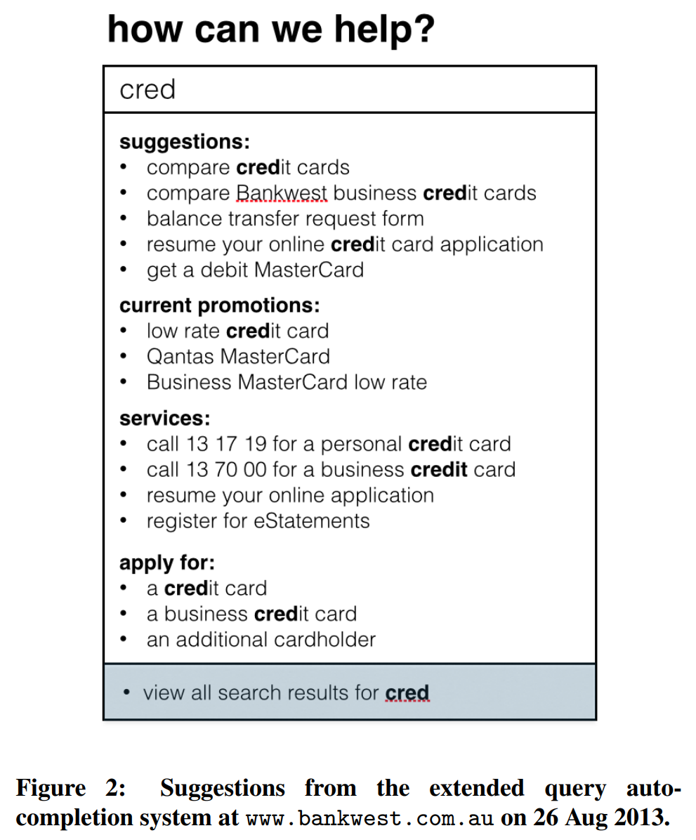
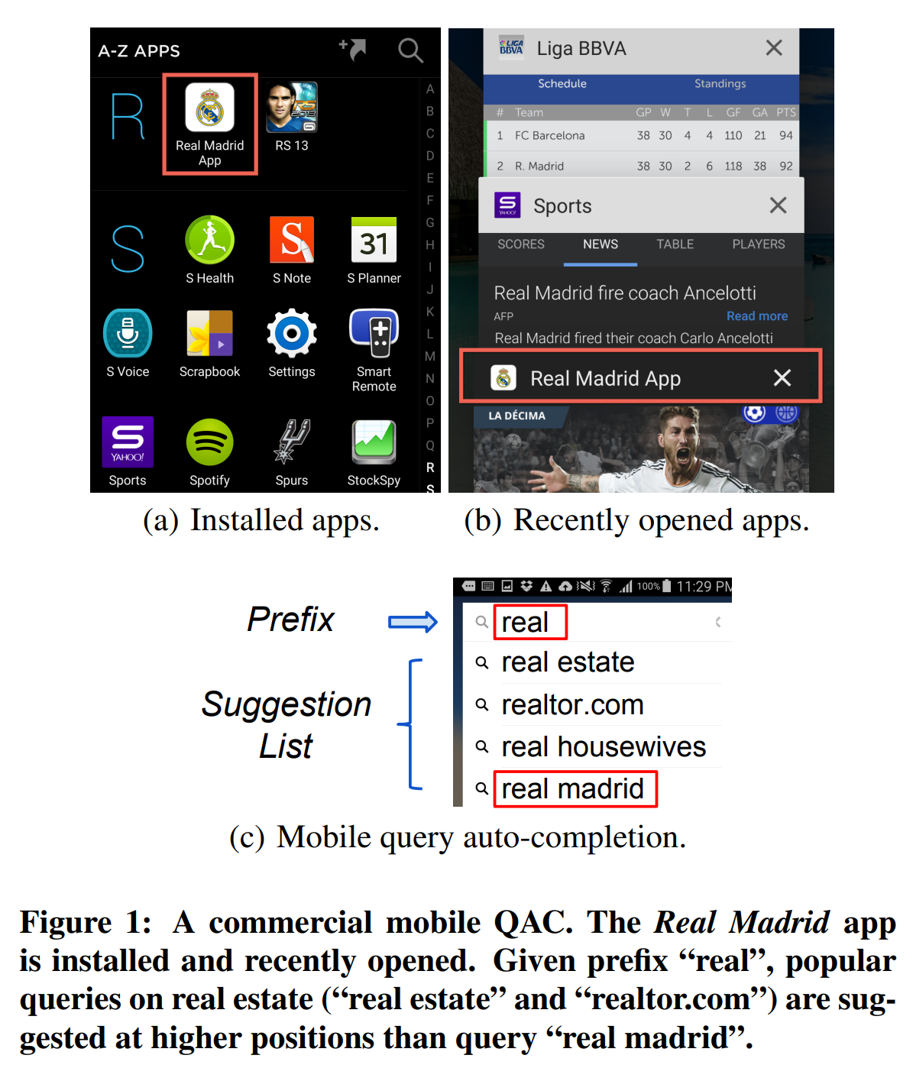
Mobile QAC, Enterprise QAC
Zhang, Aston, Amit Goyal, Ricardo Baeza-Yates, Yi Chang, Jiawei Han, Carl A. Gunter, and Hongbo Deng. "Towards mobile query auto-completion: An efficient mobile application-aware approach." In WWW, pp. 579-590. 2016.
Hawking, David, and Kathy Griffiths. "An enterprise search paradigm based on extended query auto-completion: do we still need search and navigation?." In Proceedings of the 18th Australasian Document Computing Symposium, pp. 18-25. 2013.

Slide 25
Agenda
Components in Query Auto Completion systems
Natural Language Generation
Personalization
Handling defective suggestions and prefixes

Slide 26

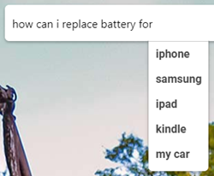
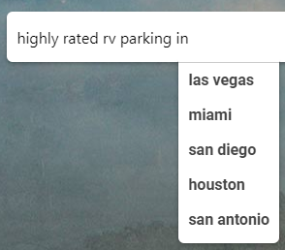
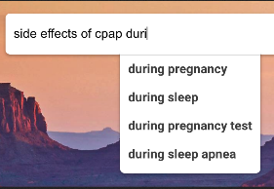
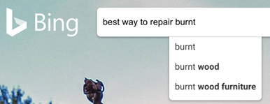

NLG for QAC
Technical challenges
Handling partial words in the input
Optimization of computation requirements and throughput
Model compression/distillation
Beam search vs greedy decoding
Considerations
Multi-language support
Inappropriate leakage
Suggestion quality
Coverage
Latency

Slide 27
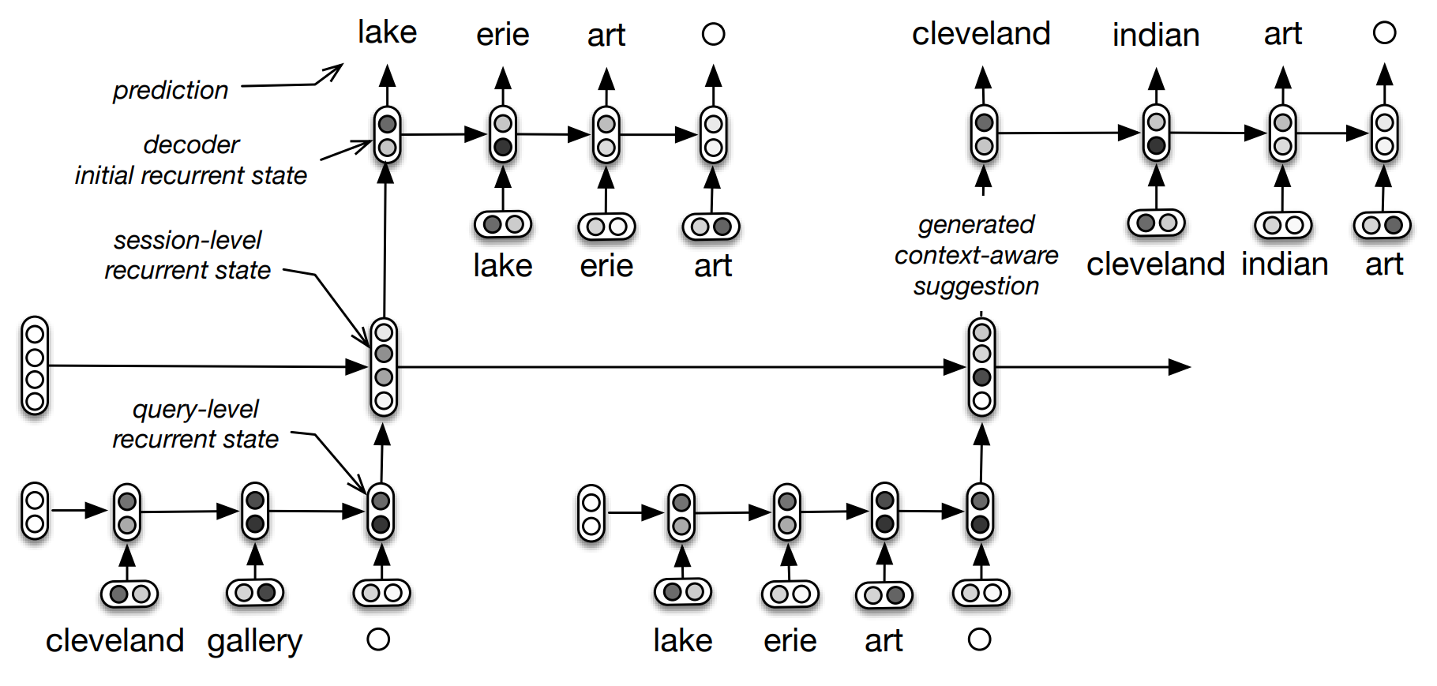
Hierarchical recurrent encoder-decoder (HRED)
Given a session S={$Q_{1}$,...,$Q_{M}$}, we aim to predict the target query $Q_{M}$ given the context $Q_{1}$,…,$Q_{M−1}$.
HRED generates synthetic suggestions sampled one word at a time.
Useful for rare, or long-tail, queries.
The user types “cleveland gallery → lake erie art”. During training, the model encodes “cleveland gallery”, updates the session-level recurrent state and maximizes the probability of seeing “lake erie art”. The process is repeated for all queries in the session. During testing, a contextual suggestion is generated by encoding the previous queries, by updating the session-level recurrent states accordingly and by sampling a new query from the last obtained session-level recurrent state. Here, the generated contextual suggestion is “cleveland indian art”.
Sordoni, Alessandro, Yoshua Bengio, Hossein Vahabi, Christina Lioma, Jakob Grue Simonsen, and Jian-Yun Nie. "A hierarchical recurrent encoder-decoder for generative context-aware query suggestion." In CIKM, pp. 553-562. 2015.

Slide 28
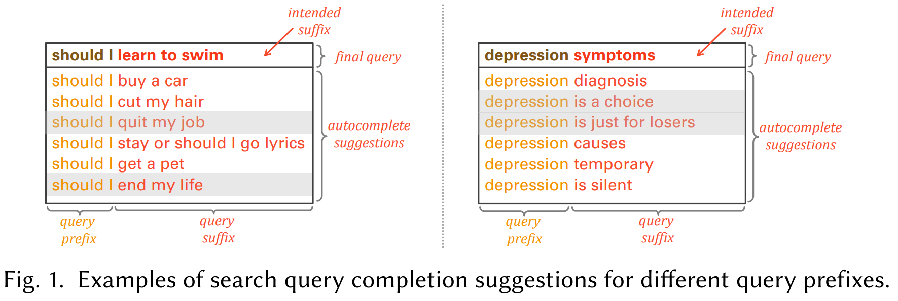
When Are Search Completion Suggestions Problematic?
15% to 47% of problematic suggestions were flagged as problematic due to the query prefix they were surfaced for.
Search voids: rare query prefixes to be up to 3 times more likely to be linked to problematic suffixes.
Problematic suggestions can also affect those issuing the search query if e.g., their dignity is compromised
Suggesting ... [bed bugs by yourself] when a user typed how to kill [...] may imply the system deduced the user has a bed bugs infestation issue.
Suggesting ... [my arrest records] when a user typed how to find [...] may hint the system assumed that such records may exist
Racist or sexist
Containing profanity or violence
Subtle ways
A certain phrase may be bothersome for some group of users, but not for others.
A suggestion such as “ … is evil” or “… is huge” may be acceptable if the user input was “heinous crime …” or “the universe …,” but likely problematic if it was a person’s name
Olteanu, Alexandra, Fernando Diaz, and Gabriella Kazai. "When Are Search Completion Suggestions Problematic?." Proceedings of the ACM on Human-Computer Interaction 4, no. CSCW2 (2020): 1-25.

Slide 29
Agenda
Components in Query Auto Completion systems
Natural Language Generation
Personalization
Handling defective suggestions and prefixes

Slide 30
Personalization for QAC
Using short-term/long-term user history, location, other signals
Search/Click History:
the wolf of wall street
the revenant
inception
gangs of new york
pain & gain
Search/Click History:
tender is the night
f. scott fitzgerald
this side of paradise
the silent patient
the great gatsby book
Search/Click History:
the wolf of wall street
the revenant
inception
gangs of new york
pain & gain
Long-term
Session history
beijing travel advisory
forbidden city
the great gatsby fitzgerald
the great gatsby book
the great influenza
the great alone book
the great gatsby film 2013
the great gatsby film 2013
the great gatsby trailer
the great gatsby film 1974
the greatest showman
the great wall film 2016
the great wall of china
the great gatsby film 2013
the great gatsby trailer
the great gatsby film 1974
the greatest showman
Notes:
Recap of personalization scenario

Slide 31
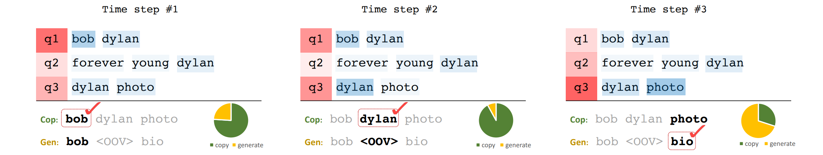
Attend, Copy, Generate (ACG)
Example of generating a suggestion query given the previous queries in the session. The suggestion query is generated during three time steps. The heatmap indicates the attention, red for query-level attention and blue for word-level attention. The pie chart shows if the network decides to copy or to generate.
Dehghani, Mostafa, Sascha Rothe, Enrique Alfonseca, and Pascal Fleury. "Learning to attend, copy, and generate for session-based query suggestion." In CIKM, pp. 1747-1756. 2017.

Slide 32
Agenda
Components in Query Auto Completion systems
Natural Language Generation
Personalization
Handling defective suggestions and prefixes

Slide 33
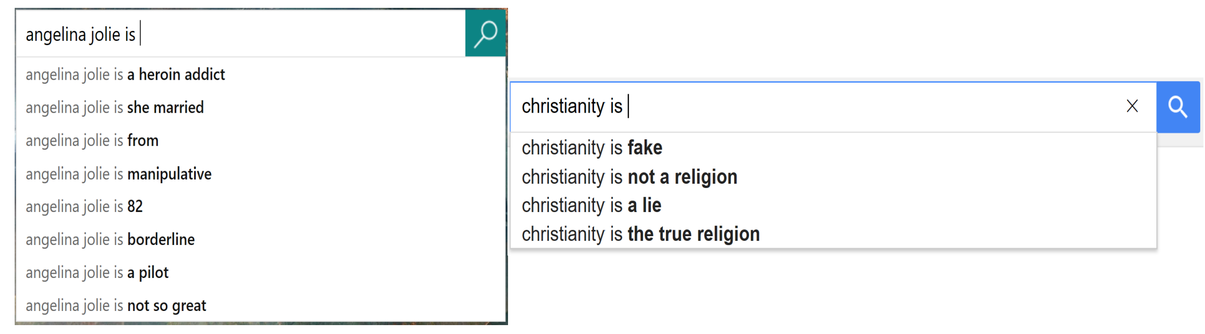
Inappropriate query suggestion detection
Inappropriate: if it may cause anger, annoyance to certain users or exhibits lack of respect, rudeness, discourteousness towards certain individuals/communities or may be capable of inflicting harm to oneself or others.
Yenala, Harish, Manoj Chinnakotla, and Jay Goyal. "Convolutional Bi-directional LSTM for detecting inappropriate query suggestions in web search." In PAKDD, pp. 3-16. Springer, Cham, 2017.

Slide 34
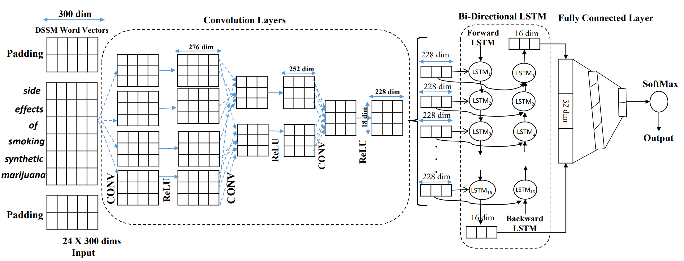
CONV+BiLSTMs for Inappropriate query suggestion detection
Randomly initialize the DSSM word vectors for these padded unknown words from the uniform distribution [-0.25, 0.25].
Use three 3 × 25 filters.
Yenala, Harish, Manoj Chinnakotla, and Jay Goyal. "Convolutional Bi-directional LSTM for detecting inappropriate query suggestions in web search." In PAKDD, pp. 3-16. Springer, Cham, 2017.

Slide 35

Thanks!
HomePage: https://sites.google.com/view/manishg/
Google Scholar: https://scholar.google.co.in/citations?user=eX9PSu0AAAAJ
LinkedIn: http://aka.ms/manishgupta
YouTube (Data Science Gems): https://www.youtube.com/@dlByManish

